Slide 1


HEALTH INSURANCE -
RENEWAL PREDICTIONAND CUSTOMER SEGMENTATION ANALYSIS

Slide 2






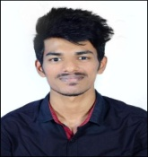
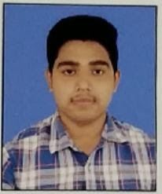

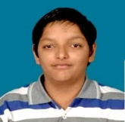


Project Team Members
Abhinav Tiwari
www.linkedin.com/in/abhinav-tiwari-38146a19a
Ravirala Bindu Priya
https://www.linkedin.com/in/ravirala-bindupriya-49bb931a2
Amit Kumar
https://www.linkedin.com/in/amit-kumar-20098a148/
Akansha Tiwari
https://www.linkedin.com/in/akansha-tiwari-0430371ba
Bibhut Bhusan Sahu
linkedin.com/in/bibhuti-bhusan-sahu-167328203/
Gaurav Sharma
linkedin.com/in/gaurav-sharma-823687202
Nithin Dsouza
www.linkedin.com/in/nithinsouza
Piku Maity
https://www.linkedin.com/in/piku-maity-691943170
Praveen Kumar
https://www.linkedin.com/in/praveen-kumar-s-1110
Rahul Durgaraju
www.linkedin.com/in/rahul-durgaraju-7b19a2158
Sanjaya Kumar Khadanga
https://www.linkedin.com/in/sanjaya-kumar-khadanga-b288b9102
Srinivas Tata
https://www.linkedin.com/in/srinivas-tata-11702a172/

Slide 3


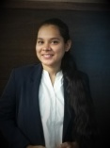
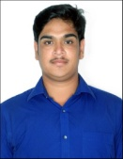





Shreyas A B
linkedin.com/in/shreyas-a-b-632078203
Srishti Maan
linkedin.com/in/srishti-maan-8312b5213
Vaishali Dahre
https://www.linkedin.com/in/vaishali-dahre-716515165/
MOHAMMED SUHAIL
https://www.linkedin.com/in/mohammed-suhail-82a94b153/
Naveen Kumar G
https://www.linkedin.com/in/naveen-kumar-g-b6a0646b/
ADITYA NAVUDURI
https://www.linkedin.com/in/aditya-navuduri-bb8271143
Neelu Singh
https://www.linkedin.com/in/neelu-singh-8286b91b1
Shivansh Nigam
www.linkedin.com/in/shivansh-nigam-69285a176
Ayush Kumar Upadhyaya
http://www.linkedin.com/in/ayush-upadhyay-906b25193

Slide 4
Medical Insurance

Slide 5

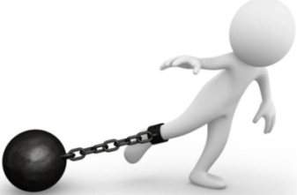
Project Goals
Objectives
Constraints
The objective is to predict insurance policy renewals for existing customers using predictive modeling.
To segment existing customers for better targeting through focused marketing strategies.
We are provided with only data dictionary mentioning the features only but not with the real data.
Minimize the fraudulent claims.
HIPAA Compliance(Health Insurance Portability and Accountability Act) based on the data protection.

Slide 6
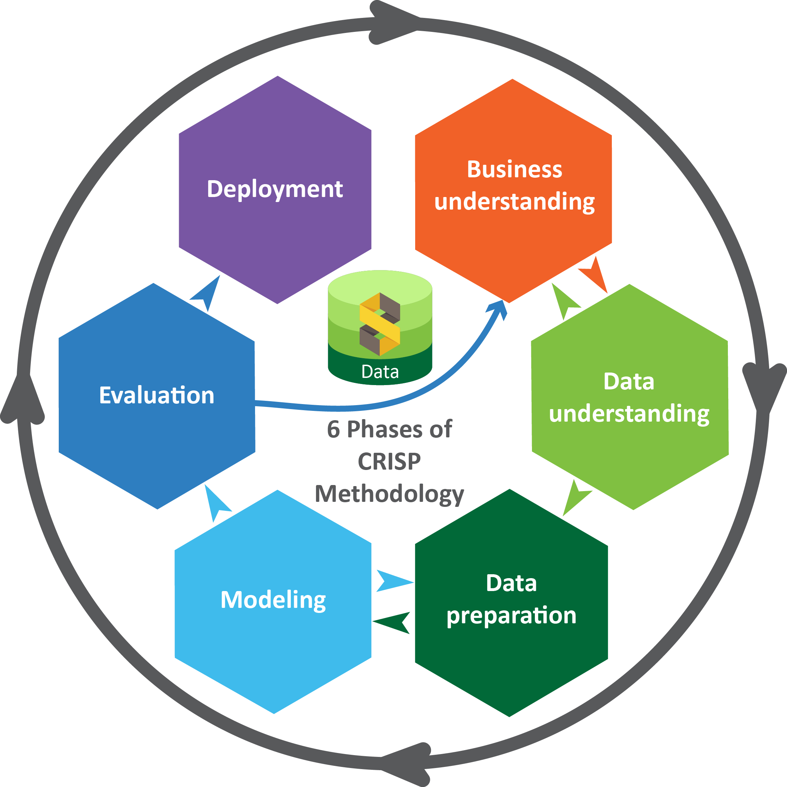
Business pipeline: CRISP-ML Methodology

Slide 7

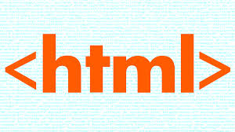






Technical Stacks
These are the Software, Tools and Environments used in the project.
HTML,CSS, JS: Cascading Style Sheets (CSS) is used for describing the presentation of a document written in a markup language such as HTML. CSS is a cornerstone technology of the World Wide Web, alongside HTML and JavaScript.
Flask: Flask helps end users interact with your python code (in this case our ML models) directly from their web browser without needing any libraries, code files.
Tableau: A tool we used for visualization.
MySQL : A tool used for storing databases.

Slide 8
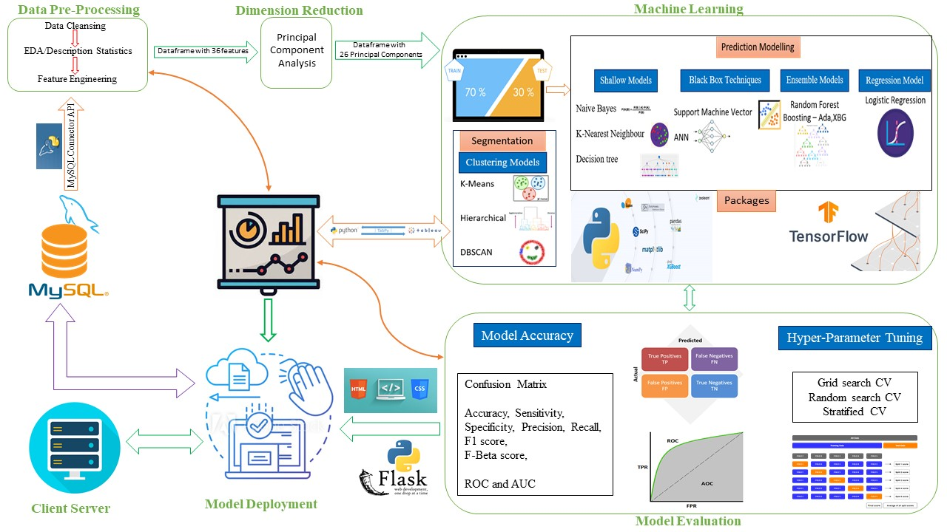
Project Architecture / Data Pipeline

Slide 9

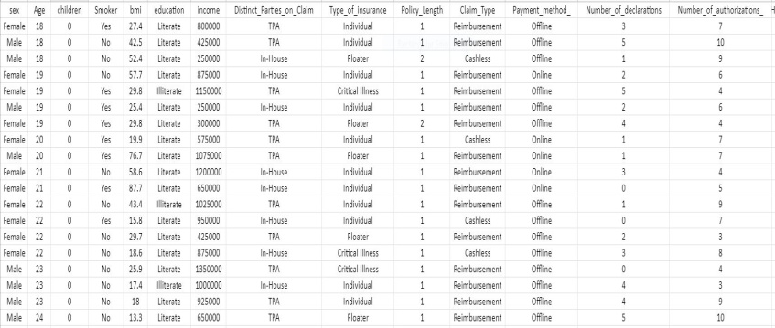
Data Preparation
Data used for training the model is validated to the best of our domain knowledge and also insights are taken from different websites like IRDAI, Wikipedia etc. for data validation purposes.
The data description has been performed to gain insight about the underlying data generation process. The data has been described on a certain level and by their statistical properties.
Modification on the data set should be documented to mitigate the risk of obtaining irreproducible or wrong results. For our requirement the modification of the data and data version control has been documented in a proper manner.
https://drive.google.com/file/d/1AvnPGyPcJt745h2lAbQYbx0h9KJIqm1e/view?usp=sharing

Slide 10
EDA
Our dataset has 1000 observations with 41 features and is free from any missing values.
We don’t have any duplicates in our data.
We have performed outlier treatment on some features which had outliers.
Transformation techniques that were used on our data were log transformation, boxcox transformation, exponential transformation, etc. to make our data distribution free from skewness.
We have also performed normalization and standardization of data.
Dummy variables were also created for categorical variables.
Code picture

Slide 11
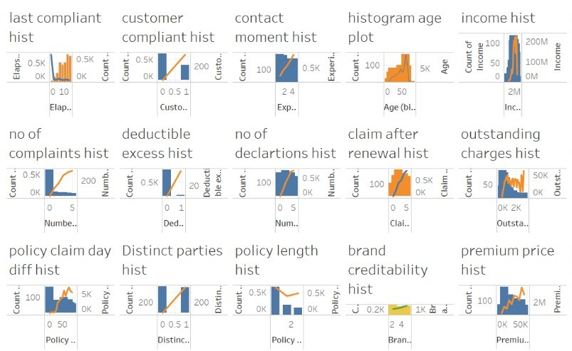
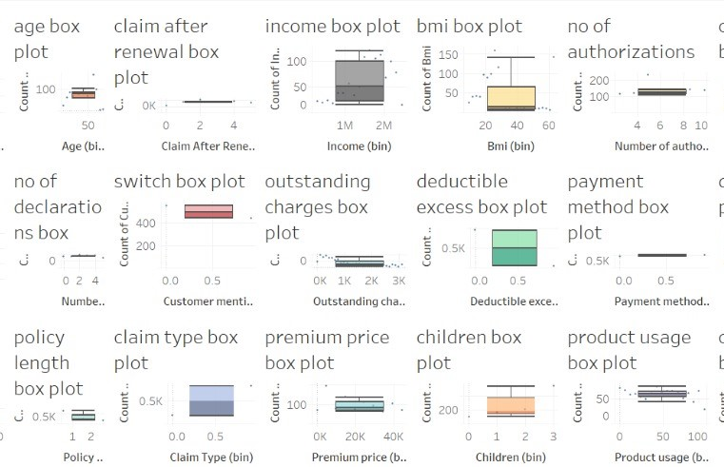

Slide 12
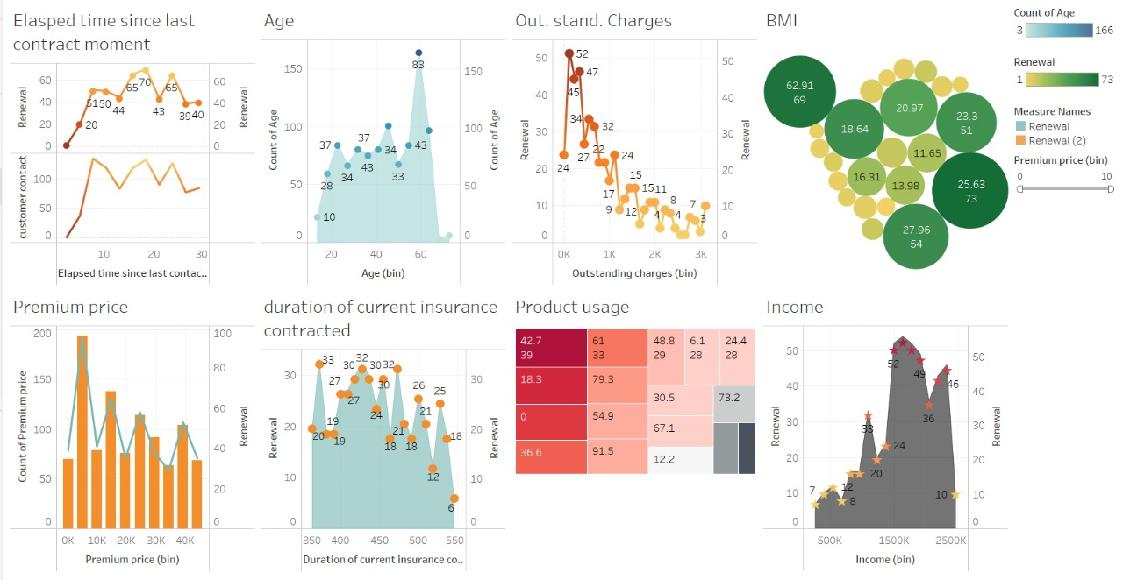

Slide 13

Model Building

Slide 14
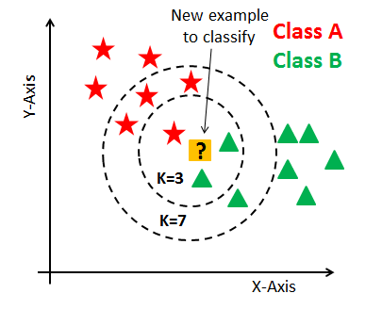
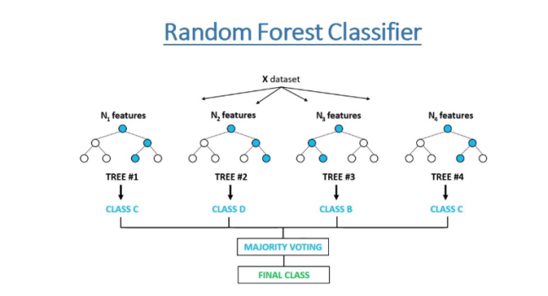
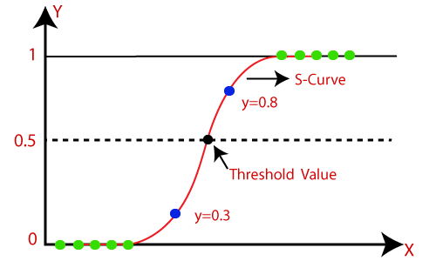
Model Prediction
Algorithms used:
Shallow models
1) K-Nearest Neighbor: K-Nearest Neighbors (KNN) is one of the simplest algorithms used in Machine Learning for regression and classification problem.
2) Naive Bayes : Naive Bayes is one of the fast and easy ML algorithms to predict a class of datasets. It can be used for binary as well as Multi-class Classifications
3) Decision tree: Decision Trees are a type of Supervised Machine Learning where the data is continuously split according to a certain parameter. The tree can be explained by two entities, namely decision nodes and leaves
Ensemble Models
1) Random Forest: A random forest is a machine learning technique that's used to solve regression and classification problems. The algorithm establishes the outcome based on the predictions of the decision trees. It predicts by taking the average or mean of the output from various trees.
Regression Model
1) Logistic Regression: Logistic regression is a supervised learning classification algorithm used to predict the probability of a target variable.

Slide 15
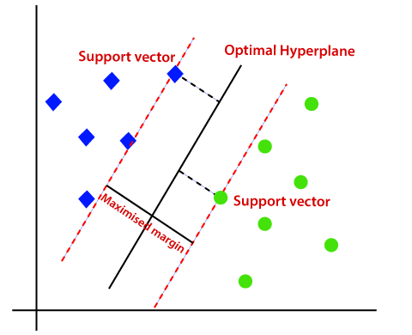
Model Prediction
Algorithms used:
Black Box Technique
1) SVM: In machine learning, support-vector machines are supervised learning models with associated learning algorithms that analyze data for classification and regression analysis.
2) ANN: An Artificial Neural Network is an information processing technique. It works like the way human brain processes information. ANN includes a large number of connected processing units that work together to process information. They also generate meaningful results from it.
Descriptions:
Split the data into training (70%) & testing (30%)
Hyper parameter Tuning

Slide 16
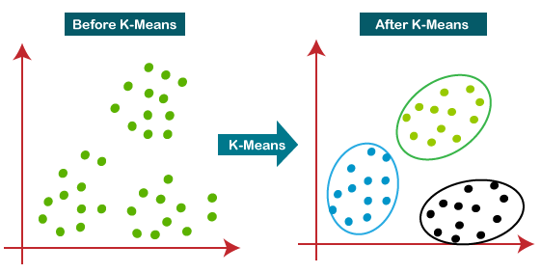
Model Segmentation
Customer segmentation is the practice of dividing a company's customers into groups that reflect similarity among customers in each group. The goal of segmenting customers is to decide how to relate to customers in each segment in order to maximize the value of each customer to the business.
Clustering methods used in this project :
1) K Means: K-means clustering aims to partition n observations into k clusters in which each observation belongs to the cluster with the nearest mean.
Code/Scree Plot

Slide 17
Segmentation in Tableau

Slide 18
Outputs of the Model in Codes
For example: Screenshots or Videos, gifs of your doings

Slide 19
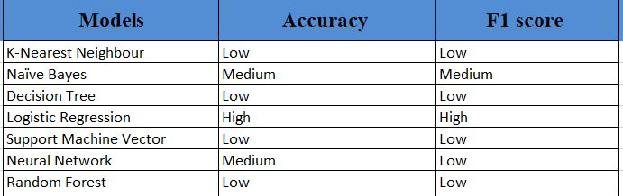
Model Evaluation
Hyper parameter tuning stuff , roc

Slide 20
SQL

Slide 21


Deployment Strategy
Web Based:
We used python flask for deployment of our model. Flask is a a web application framework written in python, in simple terms it helps end users interact with your python code (in this case our ML models) directly from their web browser without needing any libraries, code files, etc. Deployment lets you host your model in the client database.

Slide 22
Outputs of the Deployed Model
Outputs of
Universal Sentence Encoder:

Slide 23
Future Scope

Slide 24


